Slide 1
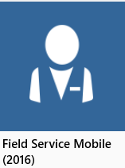




Which Field Service Mobile app to use
Not
Field Service Mobile (2016)
or
Field Service Mobile (2017)
Look for:
Field Service Mobile
Not FieldOne Sky
Available on all major App Stores: iTunes, Google Play, and the Windows Store
Not Resco MobileCRM
Not Licensed
Unique Field Service code

Slide 2
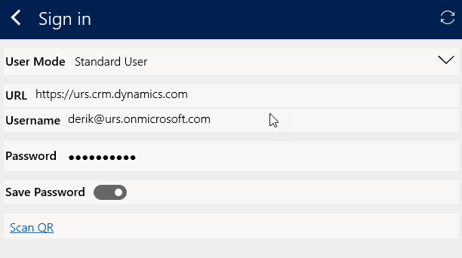
User mode corresponds with the user mode selected when the mobile project was created
Dynamics 365 login credentials

Slide 3
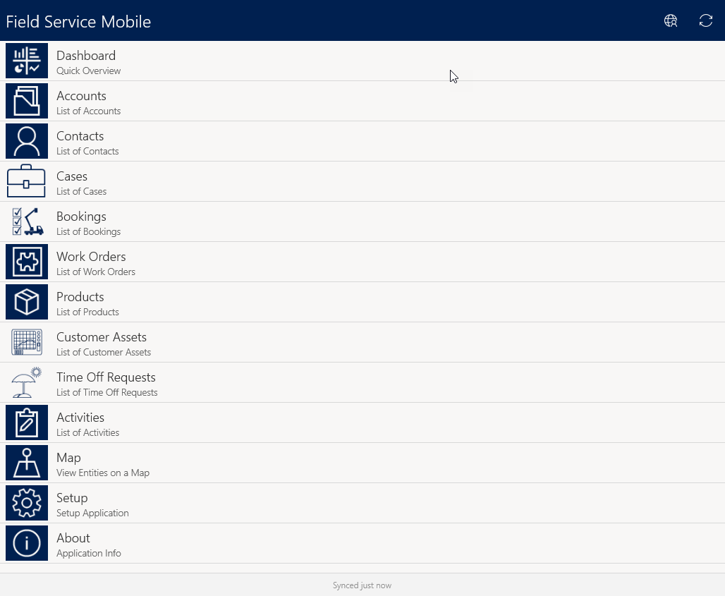
Displays whether the tech is working online or offline
Items displayed on the home screen can be added and removed at a project level

Slide 4
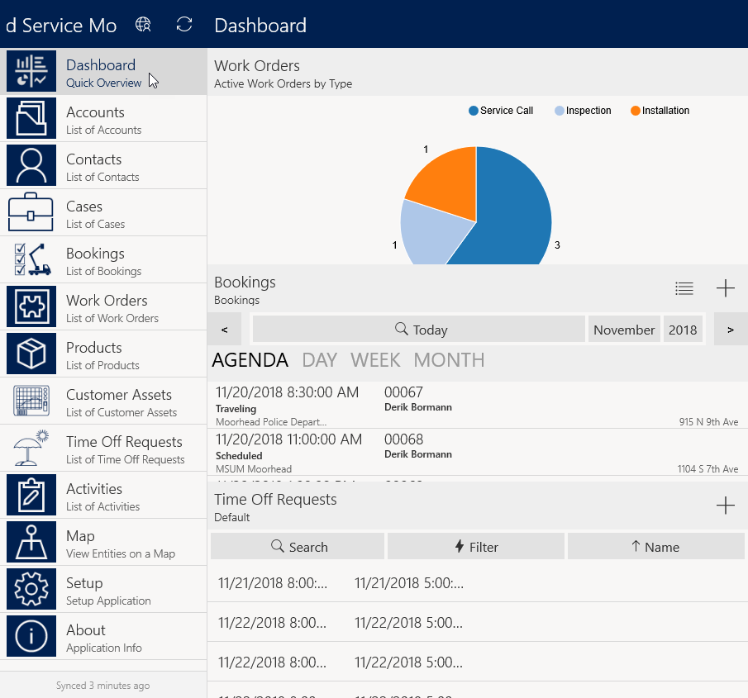
Default chart displays active work order for the tech that can be filtered by work order type
Agenda view displays active bookings for that day by default
Provides access to time off request, new requests can be submitted from here

Slide 5
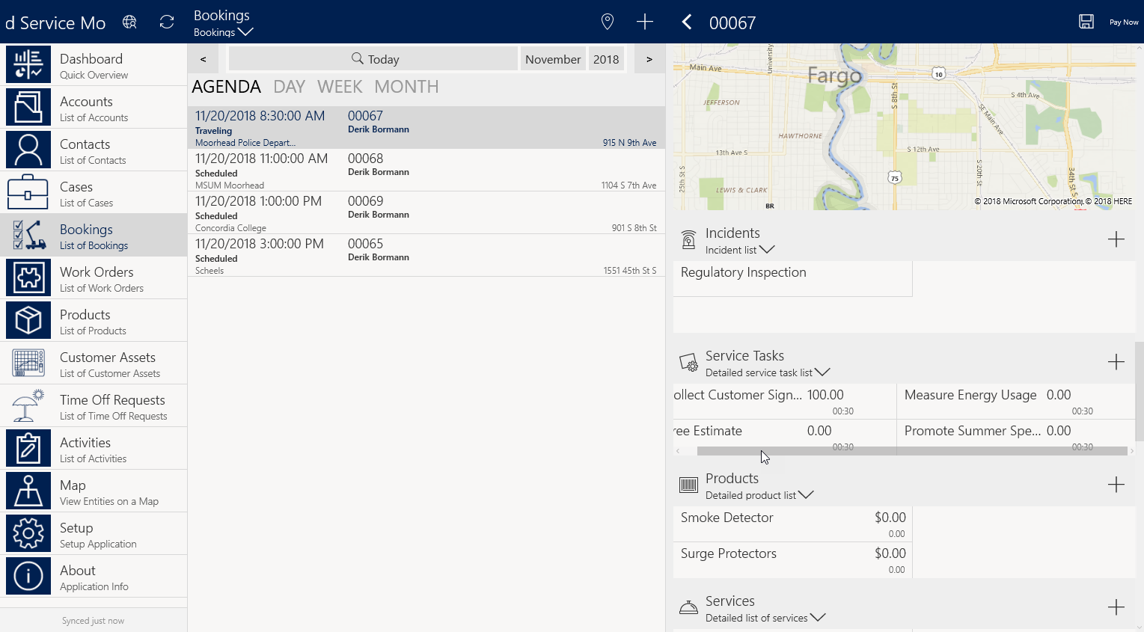
As a booking is selected, the work order associated with the booking can be drilled into to provide access to tasks, products, and services. Agent can even capture a customer signature from the record.

Slide 6
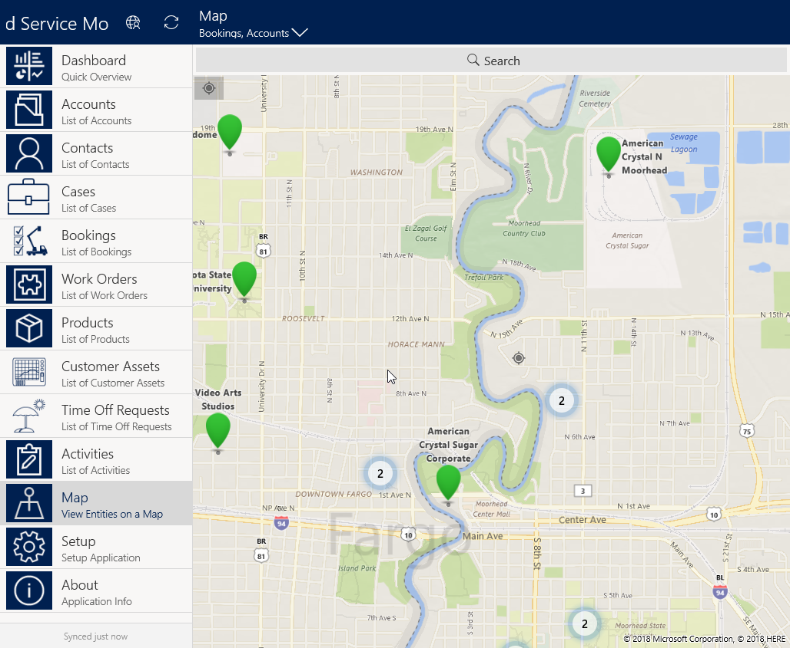
Items displayed on the map can be filtered as needed
Search control lets technicians search for specific records.
Map provides access to Accounts, Bookings, and Work Orders based on the technicians GPS location

Slide 7
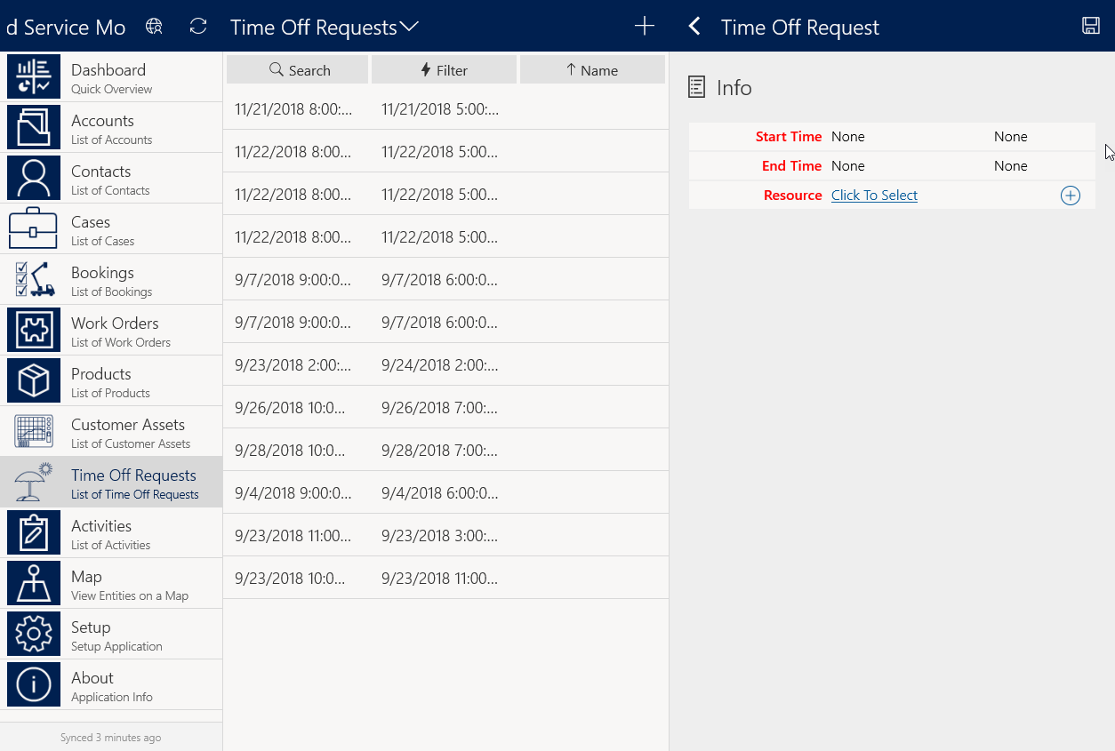
New time off requests can be added directly from the mobile application

Slide 8
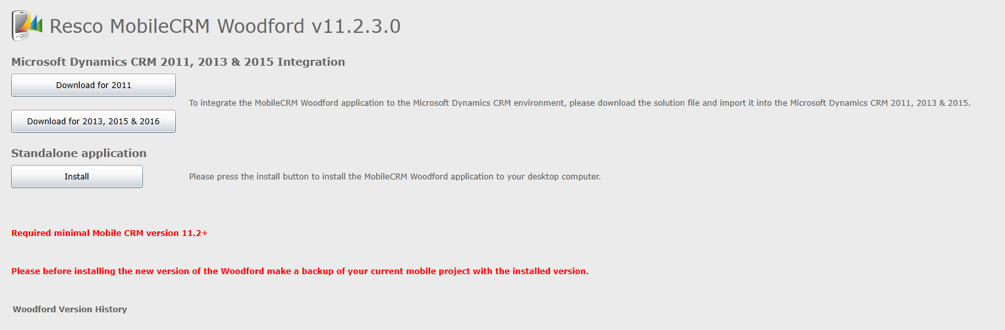
Provides access to previous versions of the solution

Slide 9
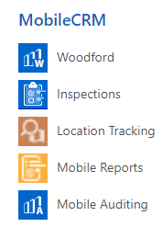

Slide 10
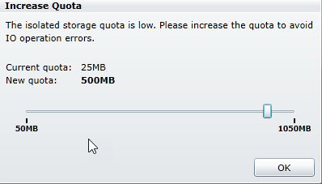

Slide 11
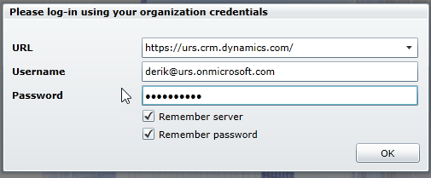

Slide 12
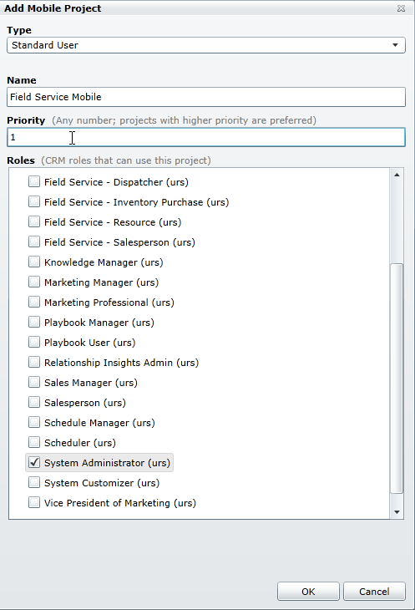

Slide 13
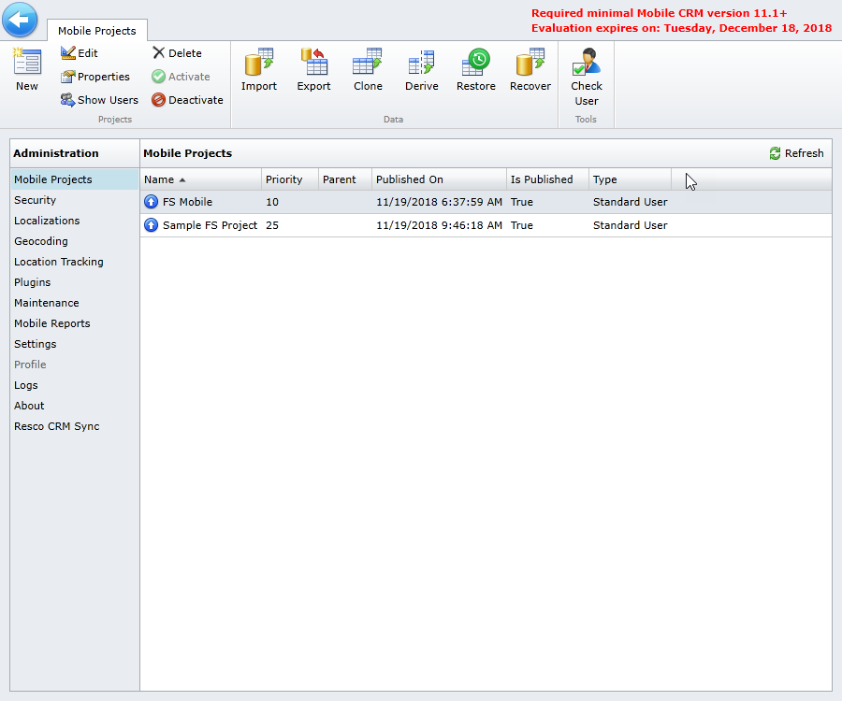
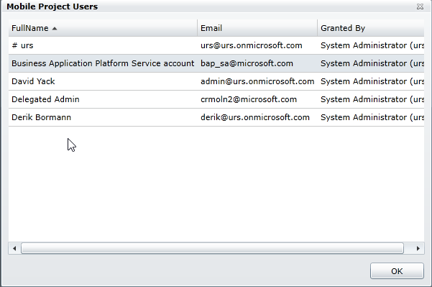

Slide 14
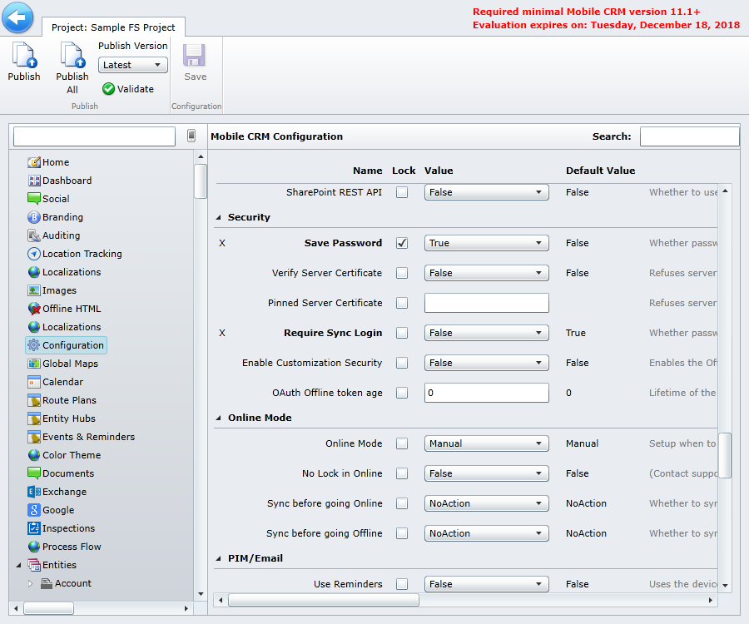

Slide 15
